Slide 1

Teamwork & Git
How to Use GitHub in a Team

Slide 2
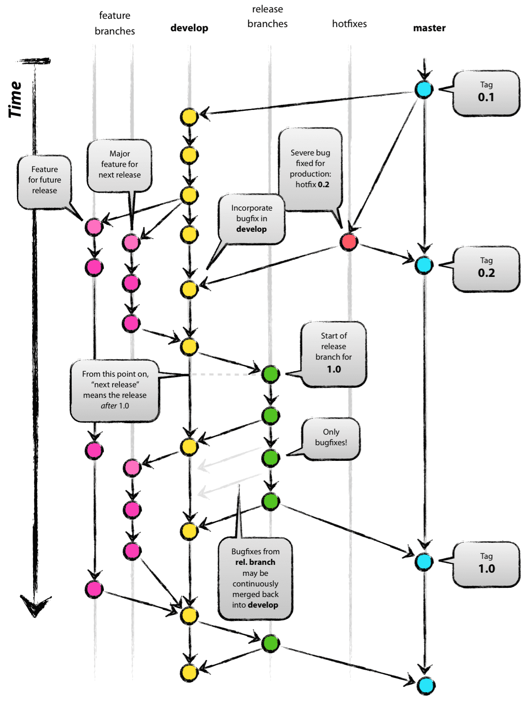
Git Flow Branch Strategy
The main idea behind the branching strategy is to isolate your work into different types of branches.
The main branch contains your production-ready code.
The other branches, feature branches, should contain work on new features and bug fixes and will be merged back into the main branch when the work is finished and properly reviewed.

Slide 3
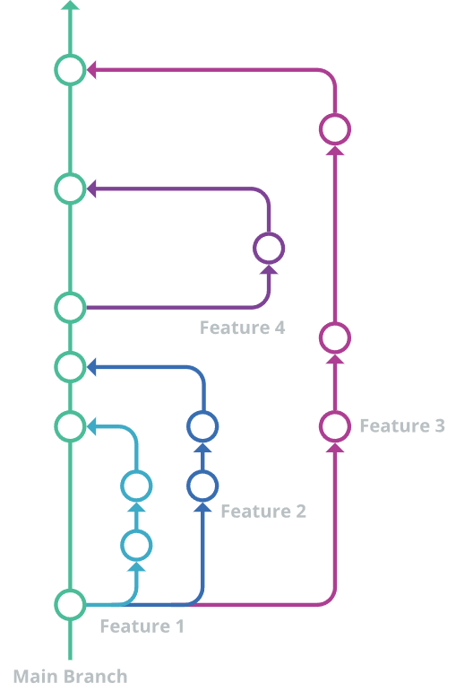
What about us?
Same flow… but simpler

Slide 4
You already know
$ git clone git@github.com:acremonezi/Projeto-Integrador-em-Computacao-II.git

Slide 5
Now... creating branches
The branch name should contain the part you plan to add, as well as your name so you have no conflicts with your teammates
git branch [branch]
$ git branch 1-danilo-readme-edit

Slide 6
... switching branches
After creating the branch you have to switch to using that branch
git checkout [branch name]
$ git checkout 1-danilo-readme-edit
… do some coding …

Slide 7
… what now?
$ git add .
$ git commit -m “#2, added some info to Readme“
($ git commit -m “Closes #2, added some info to Readme“)
first time only
$ git push --set-upstream origin 1-danilo-readme-edit
Then you just use
$ git push

